Slide 1
Understanding the problem
Using models

Slide 3
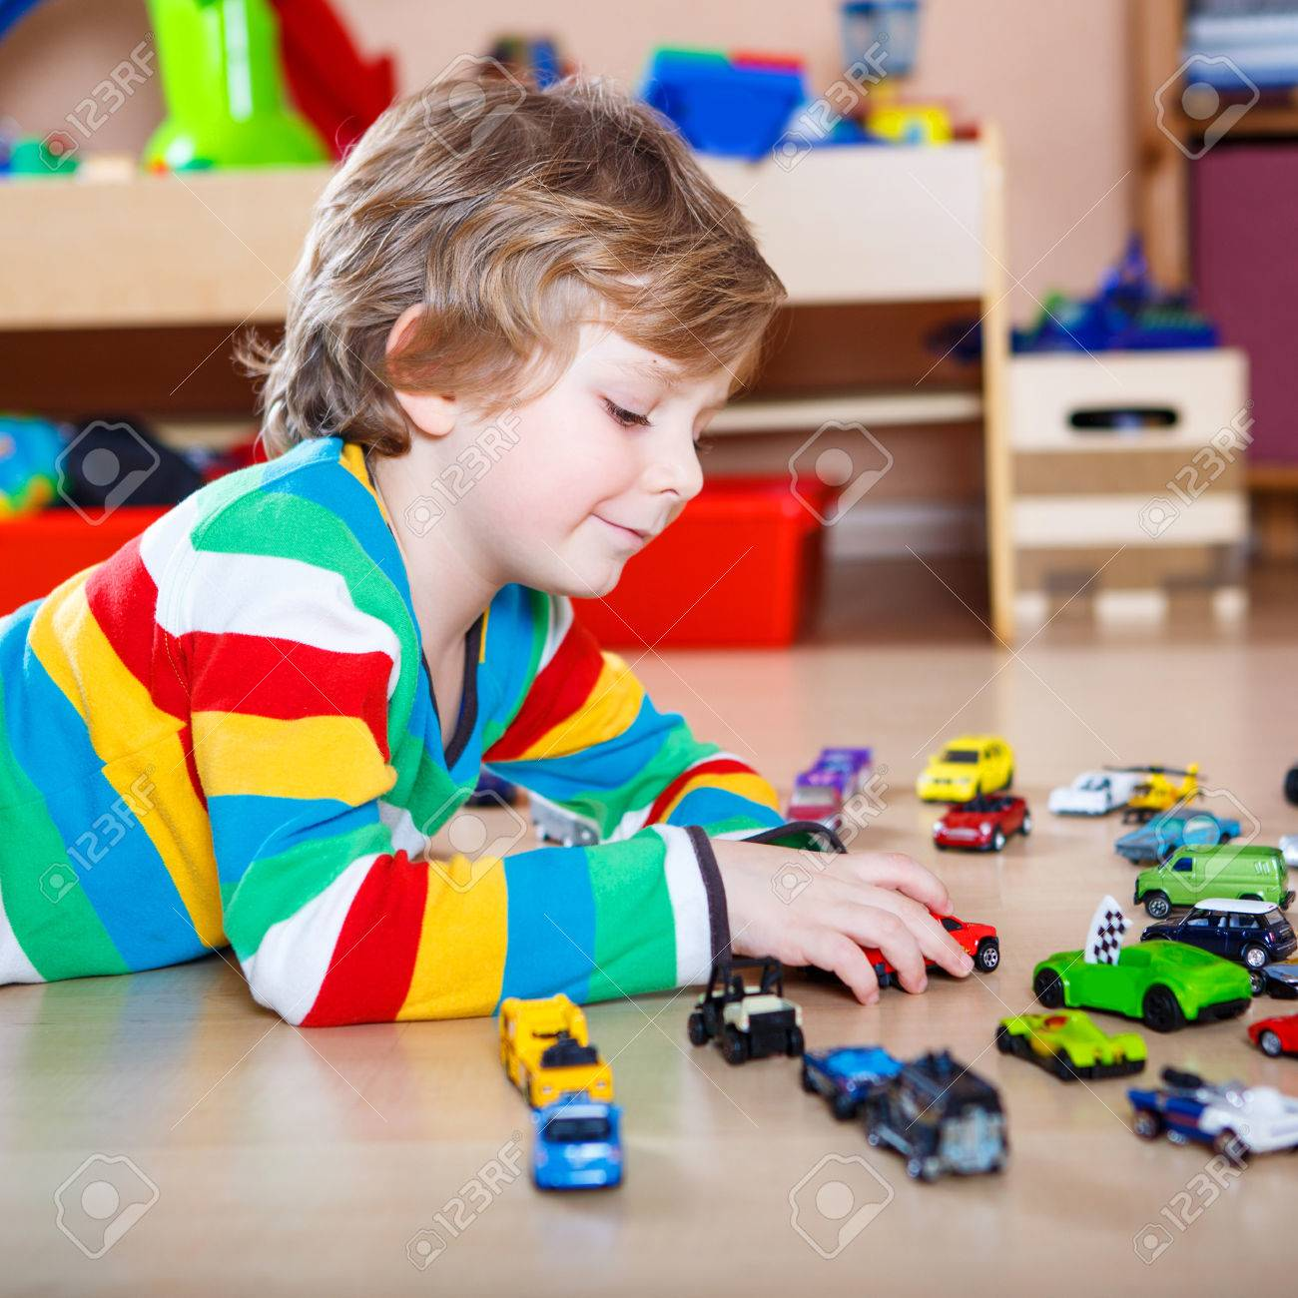
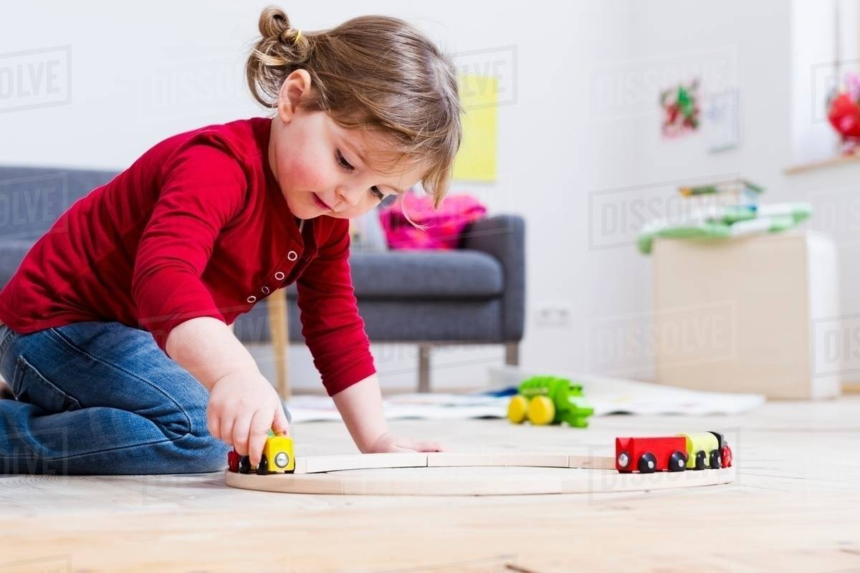
24 toy cars 29 toy cars
Total?

Slide 5
Monday, September 2nd Composition
My friend Jonny read 18 pages last night and I read 28 pages. How many pages did we read all together?

Slide 6
(date) transformation
When Jose started the year he had 24 colored pencils, but he lost 7 of them. How many colored pencils does he have left?

Slide 7
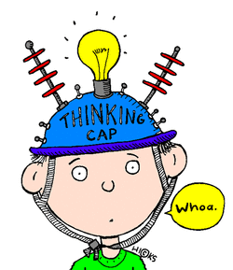
Composition or Transformation?
Alejo’s father gave him 3500 pesos to spend at the store and then his grandmother gave him 5200 pesos. How many pesos does Alejo have now?

Slide 8
Composition or Transformation?
In ruta #43 there are 18 students and in ruta #17 there are 24. How many students are there in all?

Slide 9
Composition or Transformation?
Last year Jessica won 57 games in Fifa 2020 and Roberto won 44 games. How many games did they win in total?

Slide 10
Composition or Transformation?
David made 36 cookies for a mother’s day party, but his little brother ate 4 cookies before the party. How many cookies are left?

Slide 11
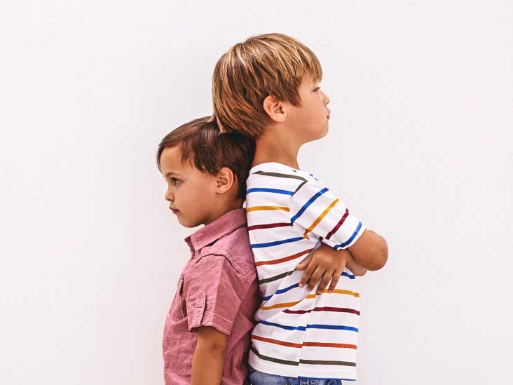
130cm
118cm

Slide 12
(date) Comparison
Last soccer season Angela scored 18 goals and her teammate Ana scored 23 goals. How many more goals did Ana score than Angela?

Slide 13
Part 1
Part 2
Total
Difference
A
B
Change
Before
Now

Slide 14
Match the Model with an example
1. CUT on lines
2. MATCH model to problem

Slide 15
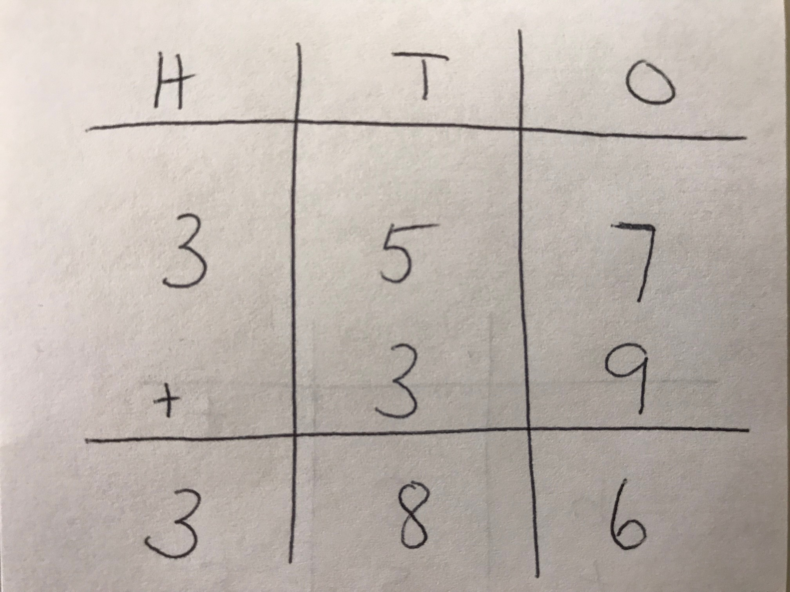
Checking Pepito’s work
Pepito’s work Inverse Operation Solve
+/- -/+ Correctly
357 + 39 = ?

